Slide 1
RAU Operating Systems 2015
Lab #2

Slide 2
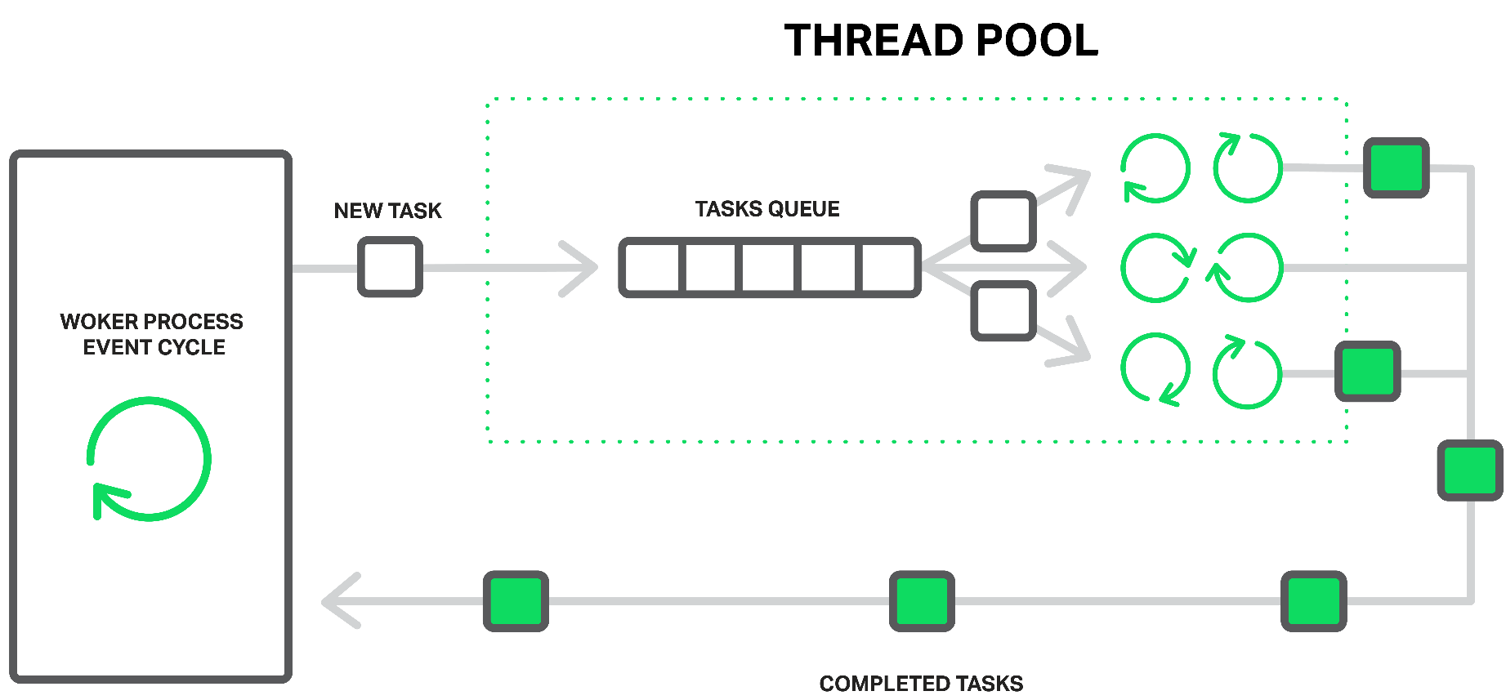
Thread Pools
Creating and destroying a thread is an expensive operation in terms of resources.
You can think of a thread pool as being a set of threads that are available for your application’s own use. There is one thread pool per CLR;
Demo
Notes:
Wastes memory resources and also hurts performance due to the operating system having to schedule and context switch between the runnable threads.
You can think of a thread pool as being a set of threads that are available for your application’s own use. There is one thread pool per CLR; this thread pool is shared by all AppDomains controlled by that CLR.
The great thing about the thread pool is that it manages the tension between having a few threads, to keep from wasting resources, and having more threads, to take advantage of multiprocessors, hyperthreaded processors, and multi-core processors. And the thread pool is heuristic. If your application needs to perform many tasks and CPUs are available, the thread pool creates more threads. If your application’s workload decreases, the thread pool threads kill themselves.
Ask about priority and about fact that thred pool threads are background threads.
Demo Exceptions.

Slide 3
Thread Pools. Asynchronous delegates.
ThreadPool.QueueUserWorkItem doesn’t provide an easy mechanism for getting return values back from a thread after it has finished executing. Asynchronous delegate invocations solve this, allowing any number of typed arguments to be passed in both directions.
Unhandled exceptions on asynchronous delegates are conveniently re-thrown on the original thread (or more accurately, the thread that calls EndInvoke), and so they don’t need explicit handling.
EndInvoke does three things. First, it waits for the asynchronous delegate to finish executing, if it hasn’t already. Second, it receives the return value (as well as any ref or out parameters). Third, it throws any unhandled worker exception back to the calling thread.
Notes:
Here’s how you start a worker task via an asynchronous delegate:
Instantiate a delegate targeting the method you want to run in parallel (typically one of the predefined Func delegates).
Call BeginInvoke on the delegate, saving its IAsyncResult return value. BeginInvoke returns immediately to the caller. You can then perform other activities while the pooled thread is working.
When you need the results, call EndInvoke on the delegate, passing in the saved IAsyncResult object.

Slide 4
Optimizing Thread Pool
You can set the upper limit of threads that the pool will create by calling ThreadPool.SetMaxThreads; the defaults are:
1023 in Framework 4.0 in a 32-bit environment; 32768 in Framework 4.0 in a 64-bit environment
250 per core in Framework 3.5;
25 per core in Framework 2.0
To illustrate, consider a quad-core computer running a client application that enqueues 40 tasks at once. If each task performs a 10 ms calculation, the whole thing will be over in 100 ms, assuming the work is divided among the four cores. Ideally, we’d want the 40 tasks to run on exactly four threads:
Any less and we’d not be making maximum use of all four cores.
Any more and we’d be wasting memory and CPU time creating unnecessary threads.
You can also set a lower limit by calling ThreadPool.SetMinThreads. The role of the lower limit is subtler: it’s an advanced optimization technique that instructs the pool manager not to delay in the allocation of threads until reaching the lower limit
Notes:
Increasing the thread pool’s minimum thread count to x doesn’t actually force x threads to be created right away—threads are created only on demand. Rather, it instructs the pool manager to create up to x threads the instant they are required
If not 10ms and random, then every half-second thread pool creates new thread.

Slide 5
Execution context
Every thread has an execution context data structure associated with it, that includes things such as security settings (compressed stack, Thread’s Principal property, and Windows identity), host settings (System.Threading. HostExecutionContextManager), and logical call context data (System.Runtime.Remoting.Messaging.CallContext’s LogicalSetData and LogicalGetData methods).
In the System.Threading namespace, there is an ExecutionContext class that allows you to control how a thread’s execution context flows from one thread to another
Demo.
Notes:
whenever a thread uses another (helper) thread to perform tasks, the issuing thread’s execution context should flow (be copied) to the helper thread. This ensures that any operations performed by helper thread(s) are executing with the same security settings and host settings. It also ensures that any data stored in the initiating thread’s logical call context is available to the helper thread. By

Slide 6
Cooperative Cancellation and Timeout
The Microsoft .NET Framework offers a standard pattern for canceling operations. This pattern is cooperative, meaning that the operation that you wish to cancel has to explicitly support being canceled.
To cancel an operation, you must first create a System.Threading. CancellationTokenSource object.
After constructing a CancellationTokenSource (a reference type), one or more CancellationToken (a value type) instances can be obtained by querying its Token property
A compute-bound operation’s loop can periodically call CancellationToken’s IsCancellationRequested property to know if the loop should terminate early, thereby ending the compute-bound operation
Demo

Slide 7
Cooperative Cancellation and Timeout (cont.)
Call CancellationTokenSource’s Register method to register one or more methods to be invoked when a CancellationTokenSource is canceled.
To CancellationTokenSource’s Register method, you pass an Action<Object> delegate, a state value that will be passed to the callback via the delegate, and a Boolean indicating whether or not to invoke the delegate using the calling thread’s SynchronizationContext
If you pass false for the useSynchronizationContext parameter, then the thread that calls Cancel will invoke all the registered methods sequentially. If you pass true for the useSynchronizationContext parameter, then the callbacks are sent (as opposed to posted) to the captured SynchronizationContext object which governs which thread invokes the callback.

Slide 8
Cooperative Cancellation and Timeout (cont.)
When have registered multiple callbacks, these callback methods could throw an unhandled exception. If we call CancellationTokenSource’s Cancel, passing it true, then the first callback method that throws an unhandled exception stops the other callback methods from executing, and the exception thrown will be thrown from Cancel as well. If you call Cancel passing it false, then all registered callback methods are invoked.
After all callback methods have executed, if any of them threw an unhandled exception, then Cancel throws an AggregateException with its InnerExceptions property set to the collection of exception objects that were thrown. If no registered callback methods threw an unhandled exception, then Cancel simply returns without throwing any exception at all.
Demo

Slide 9
Cooperative Cancellation and Timeout (cont.)
It is often valuable to cancel an operation after a period of time has elapsed
In some scenarios, it is better to respond in a short period of time with an error or with partially computed results as opposed to waiting a long time for a complete result.
CancellationTokenSource gives you a way to have it self-cancel itself after a period of time.
To take advantage of this, you can either construct a CancellationTokenSource object using one of the constructors that accepts a delay, or you can call CancellationTokenSource’s CancelAfter method.
Demo

Slide 10
Tasks
To address ThreadPool’s QueueUserWorkItem method’s limitations and more, Microsoft introduced the concept of tasks, and you use them via types in the System.Threading.Tasks namespace.
ThreadPool.QueueUserWorkItem(ComputeBoundOp, 5);
new Task(ComputeBoundOp, 5).Start(); // Equivalent of above using Task Task.Run(() => ComputeBoundOp(5)); // Another equivalent
TaskCreationOptions flags that control how the Task executes:
None = 0x0000,// The default
// Hints to the TaskScheduler that you want this task to run sooner than later. PreferFairness = 0x0001,
// Hints to the TaskScheduler that it should more aggressively create thread pool threads. LongRunning = 0x0002,
// Always honored: Associates a Task with its parent Task (discussed shortly) AttachedToParent = 0x0004,
// If a task attempts to attach to this parent task, it is a normal task, not a child task. DenyChildAttach = 0x0008,
// Forces child tasks to use the default scheduler as opposed to the parent’s scheduler. HideScheduler = 0x0010 }
Notes:
Calling ThreadPool’s QueueUserWorkItem method to initiate an asynchronous compute-bound operation is very simple. However, this technique has many limitations. The biggest problem is that there is no built-in way for you to know when the operation has completed, and there is no way to get a return value back when the operation completes.

